Slide 1

FLIGHT PRICE PREDICTION
JYOTI TRIVEDI

Slide 2
OBJECTIVE
The objectives of the project can broadly be laid down to the following questions –
Flight Trends:
Do airfares change frequently? Do they move in small increments or in large jumps? Do they tend to go up or down over time?
Best Time To Buy:
What is the best time to buy so that the consumer can save the most by taking the least risk?
Verifying Myths:
What is the best time to buy so that the consumer can save the most by taking the least risk?

Slide 3
DATA
Historic data for prediction/classification of the problem
Past flight prices for each route collected on daily basis
Python script was run on remote server which collected prices at specific times

Slide 4
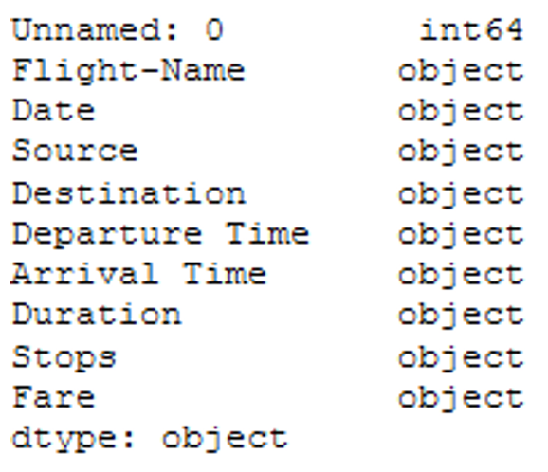
ATTRIBUTE TYPES
Data collection -> Data pre-processing
Below provides the information that the label, that is the variable that I want to predict, is continuous meaning I have a regression problem and not a classification problem that would be the case if label was discrete.

Slide 5
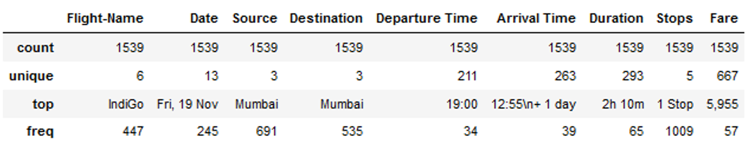
BASIC STATISTICAL MEASURES
Used basic statistical measures which provided below results

Slide 6
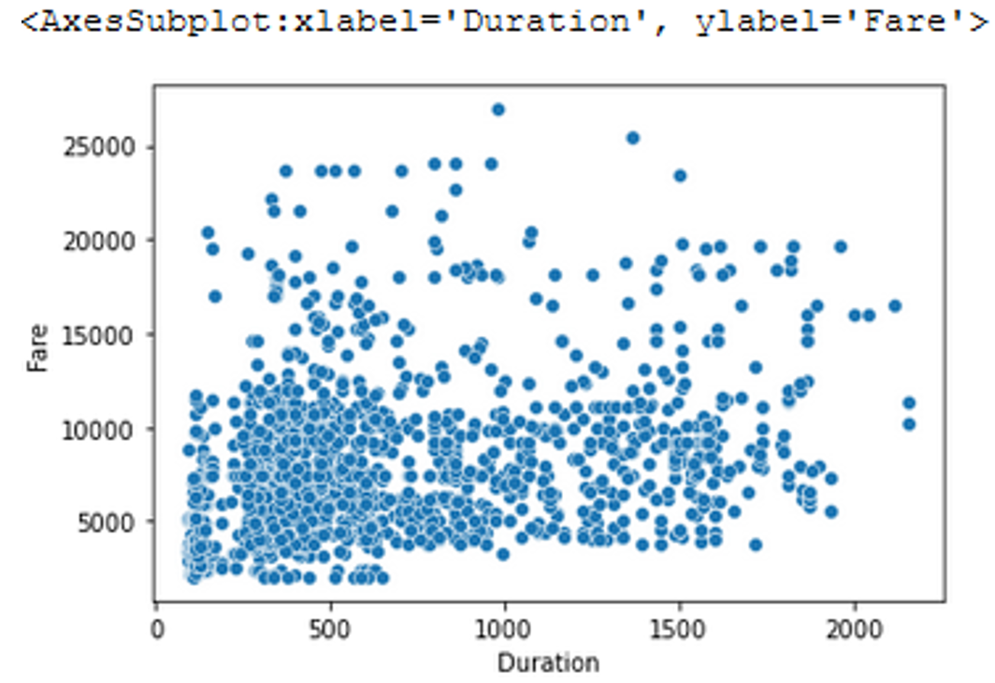
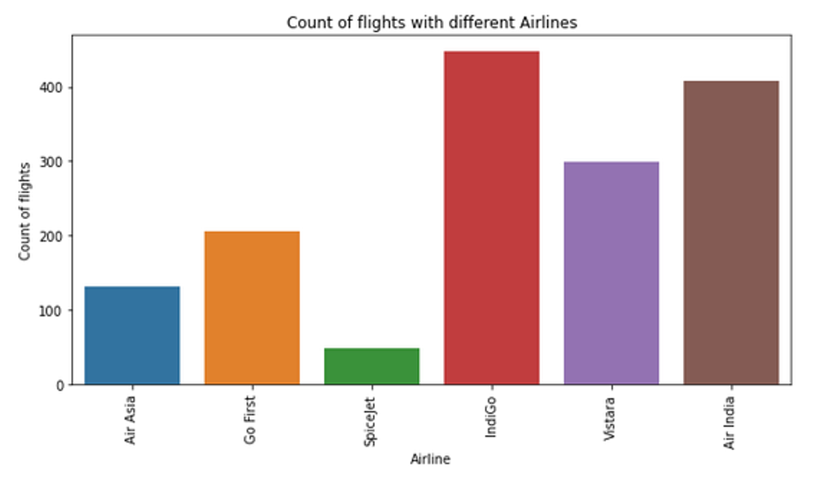
DATA VISUALIZATION
Scatter plots are used to observe relationship between variables and uses dots to represent the relationship between them.
The Matplotlib module has a method for drawing scatter plots, it needs two arrays of the same length, one for the values of the x-axis, and one for the values of the y-axis.
The scatter plot gave me a better intuition of how my variables were distributed.

Slide 7
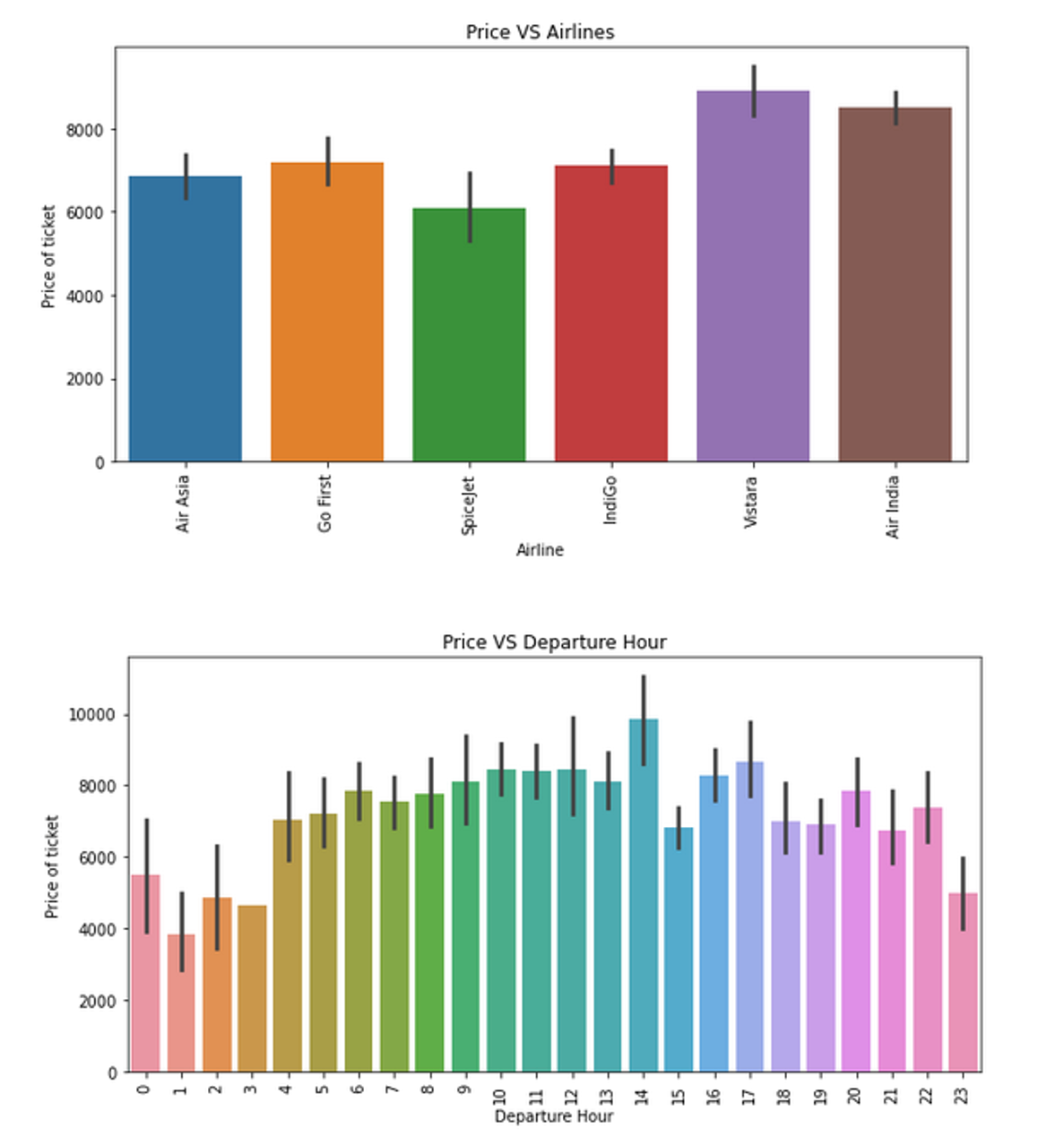
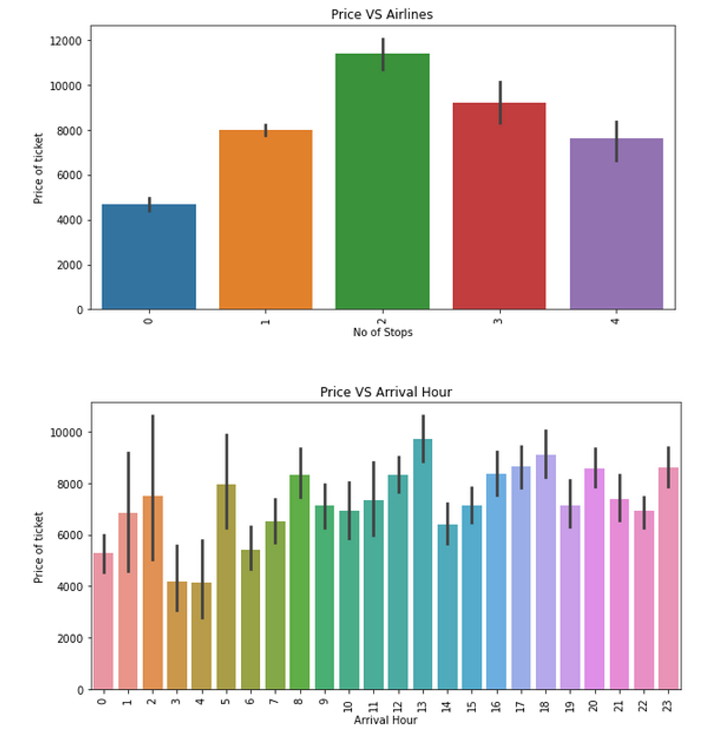
DATA VISUALIZATION

Slide 8
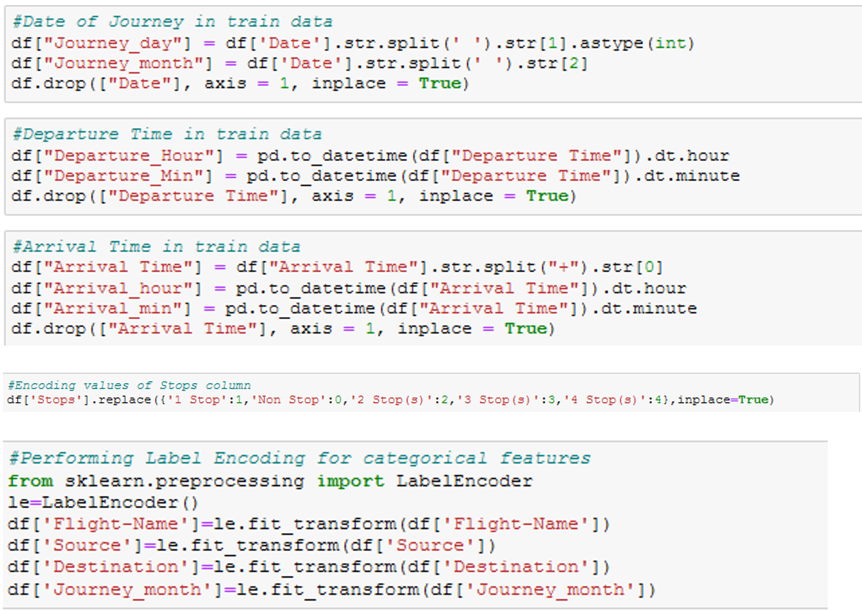
FEATURE ENGG. & SELECTION
Create Aggregated Features | Dealing with heavily Skewed features | Scaling/Normalizing numeric variables | Encodings for Categorical Variables

Slide 9
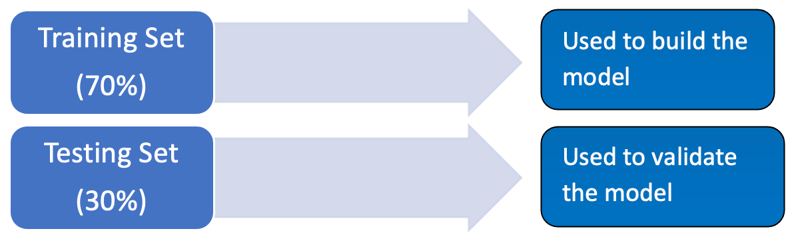
MACHINE LEARNING: SAMPLING
TRAINING SET : train the learning algorithm TEST SET : validate model and make optimization
As the model is built from the training set, we can’t check it on the same set because the result would be overly optimistic.
The test set is used only to see how well the learning algorithm is generalized, meaning how it performs with unknown data

Slide 10
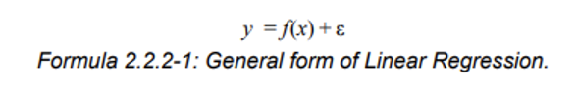
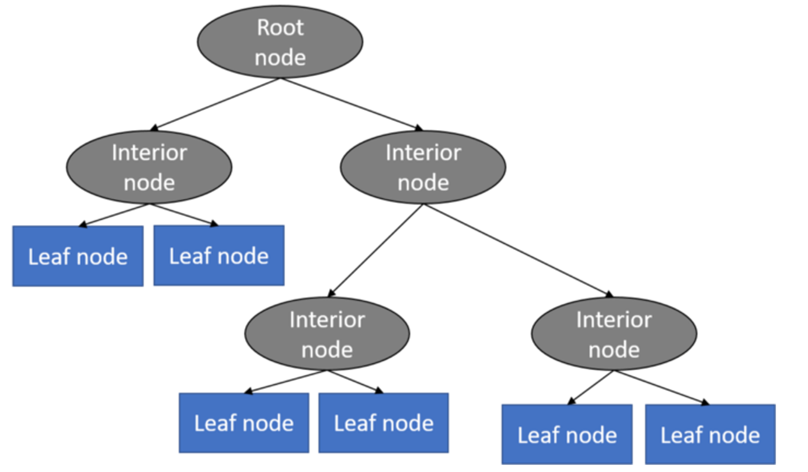
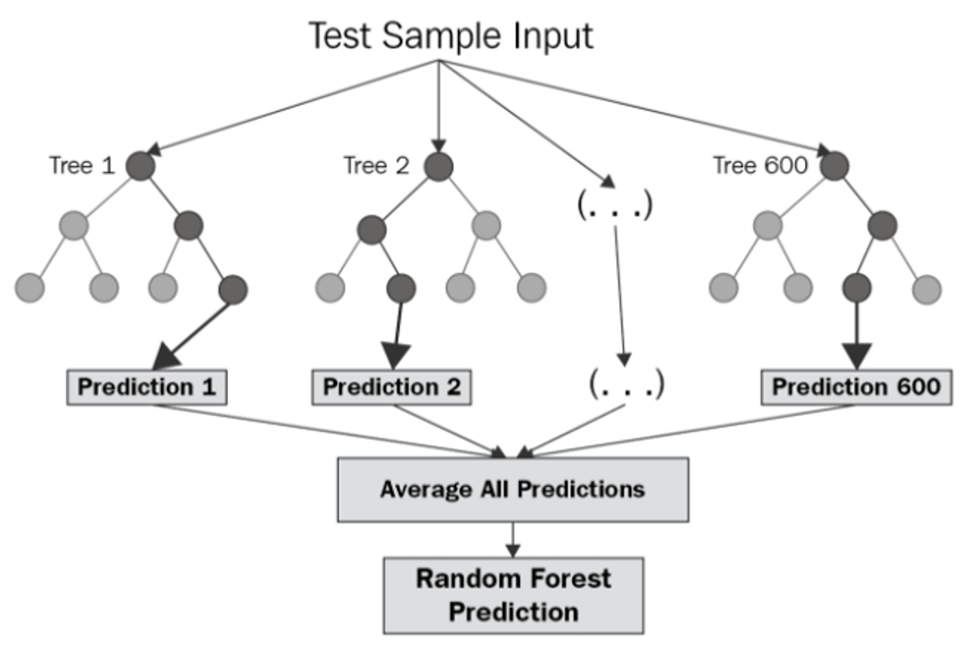
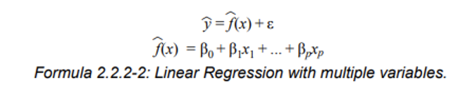
LEARNING ALGORITHM
1. Linear Regression
2. Decision Tree Regression
3. Random Forest Regression
4. K-Nearest Neighbour Regression
Approximates the association between independent variable & continuous outcome by averaging observations from the same neighbourhood.
Select size to minimize the mean square error

Slide 11
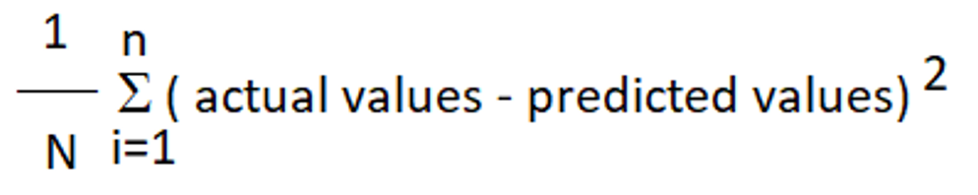
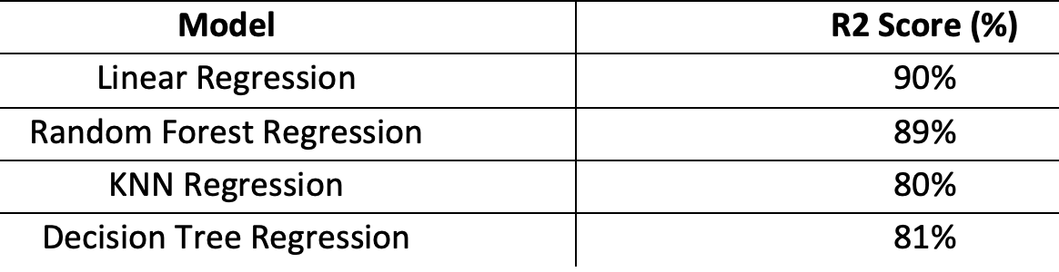
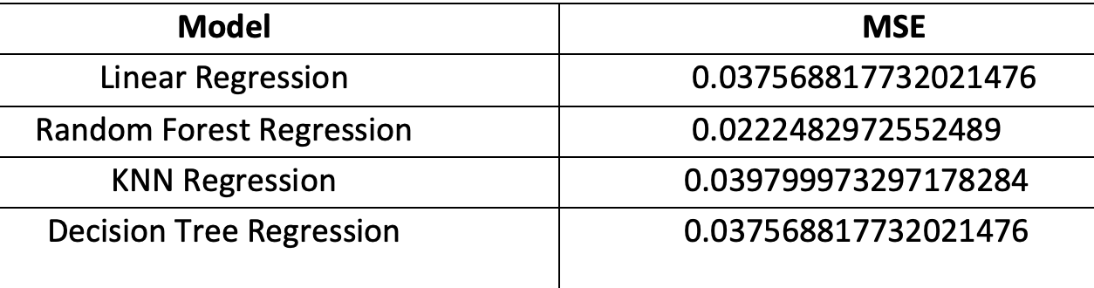
RESULTS
1. R2 Score
2. Mean Square Error (MSE)

Slide 12
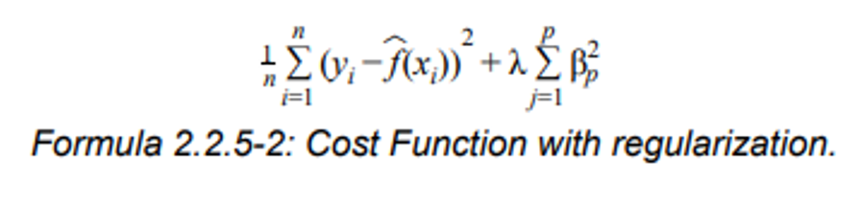
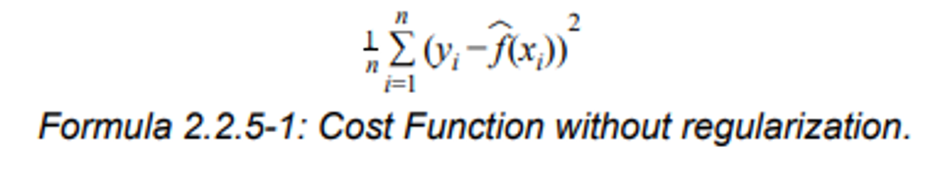
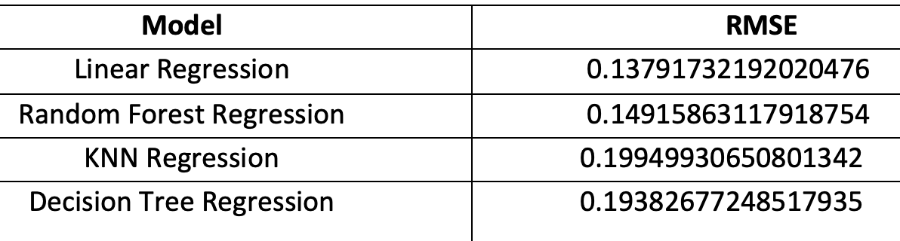
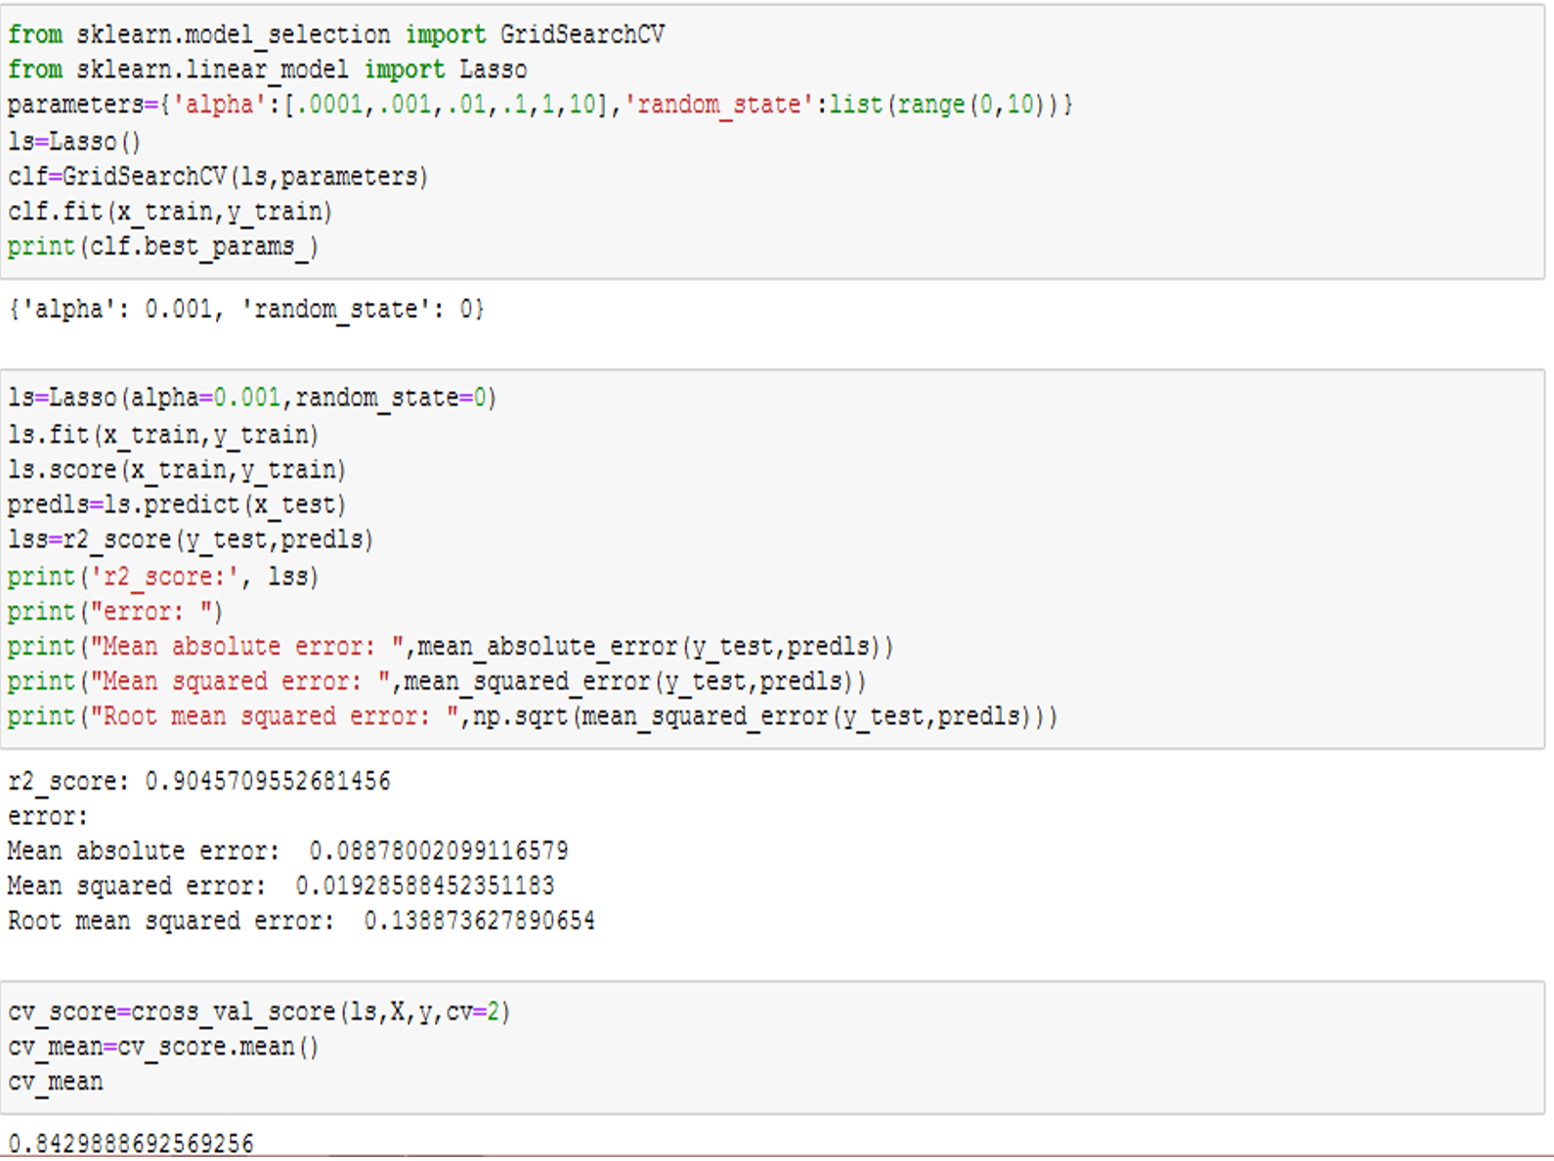
RESULTS
3. Root Mean Square Error (RMSE)
4. Regularization

Slide 13
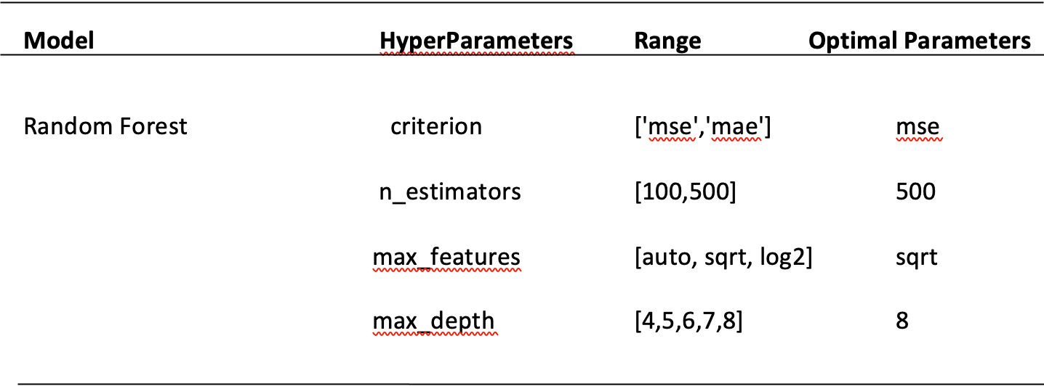
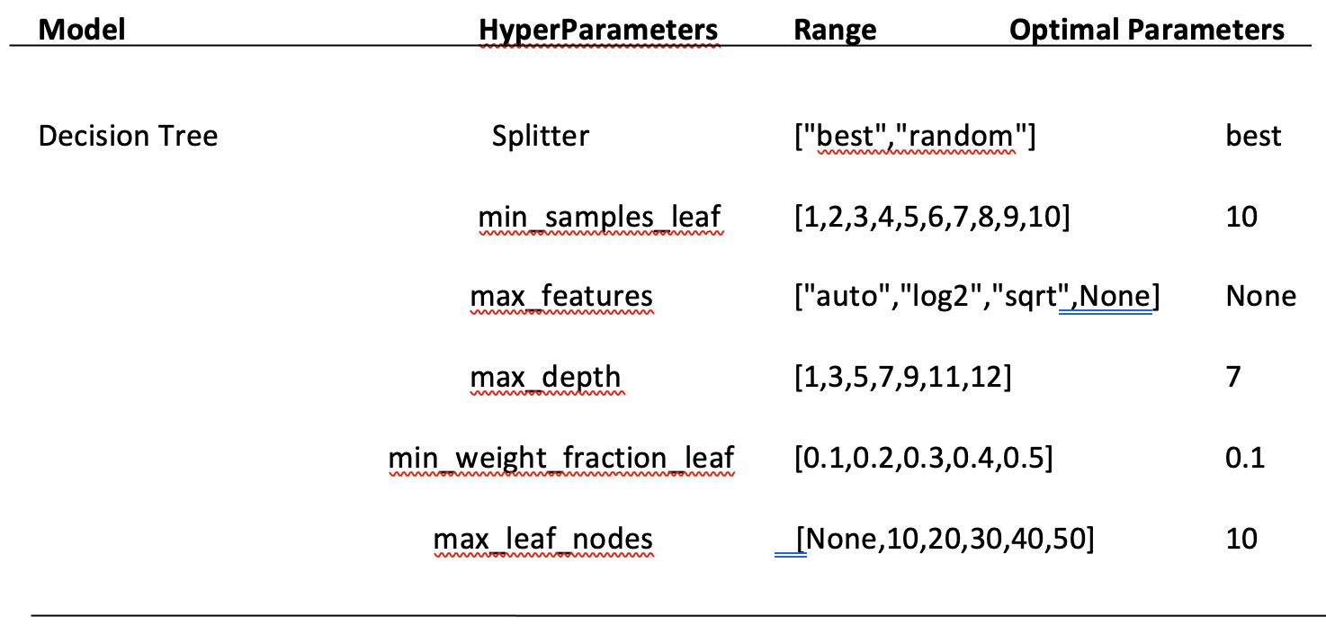
HYPER-PARAMETER TUNING
1. Random Forest
The r2 score we got after hyperparameter tuning for random forest regressor is 85% which is less than the default parameter model.
So, we choose the Random Forest Classifier with the default value as the best model for prediction.
2. Decision Tree

Slide 14
CONCLUSION
Indigo and Air India have the highest number of flights while Air asia and Spicejet being the lowest.
Fare of Vistara is the highest, followed by Air India and lowest being Spicejet.
Flights having 2 stops have more fare than 3 and 4 stops. Reason can be people won't prefer such long duration flights.
Flights with either very less duration or very large duration have least fare
Flights in the midnight and early mornings are the cheapest
Flights arriving in late mornings and afternoon are comparatively expensive.

